Slide 1
Predictive Analytics for Heart Health:
A Machine Learning Approach
Prepared By:
Md. Jafor Sadek: 1931469042
Muhammad Rafsan Kabir: 2011180042

Slide 2
Project Details
In this project, we have analysed a person’s heart health condition and predict whether they have any heart disease using various Machine Learning approaches. Heart disease, also known as cardiovascular disease, remains a leading global cause of death.
For our analysis, we have utilized a dataset titled ”Personal Key Indicators of Heart Disease,” which encompasses a total of 17 features. Among these, 9 are boolean data, 5 are strings, and 4 are decimal values. Our approach began with an exploratory data analysis (EDA) of the dataset, followed by the implementation of common Machine Learning models, including Decision Tree, Random Forest, XGBoost, Gradient Boost, Ada Boost, SVM, Logistic Regression, and Nearest Neighbor.

Slide 3
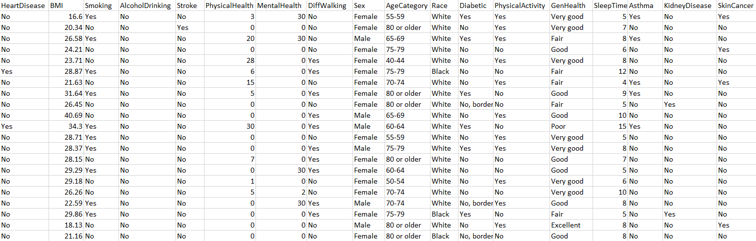
Dataset Statistics
Dataset Name: Personal Key Indicators of Heart Disease
No. of features: 17
No. of classes: 2
Size of the dataset: 319795 * 18 = 5756310 (24 MB)
No. of samples: 319795
The dataset was highly unbalanced.
Data oversampling was done using SMOTE.
No. of samples after oversampling: 548912
Dataset Snapshot

Slide 4
Training Statistics
Training time before oversampling the dataset:
Decision Tree : 0.5 sec
Random Forest : 17 sec
XGBoost : 0.6 sec
Gradient Boost : 18.7 sec
AdaBoost : 18.6 sec
SVM : 130 min
Logistic Regression : 0.6 sec
Nearest Neighbor : 27.8 sec
Training time after oversampling the dataset:
Decision Tree : 3.7 sec
Random Forest : 1 min 20 sec
XGBoost : 2.4 sec
Gradient Boost : 1 min 50 sec
AdaBoost : 29.2 sec
SVM : 198 min 31 sec
Logistic Regression : 5.7 sec
Nearest Neighbor : 32.2 sec

Slide 5
Regularization and Optimization
Regularization:
Since we did not face any overfitting issue, so we did not use any regularization technique explicitly. Some models have built-in regularizers like Logistic Regression.
In Logistic Regression, there is a penalty term, which acts like regularizer. Using GridSearchCV, we searched for the best penalty term and it was found to be ‘L2’.
Optimization:
For optimization, we have done hyperparameter fine tuning.
Hyperparameter fine tuning was done using GridSearchCV.

Slide 6
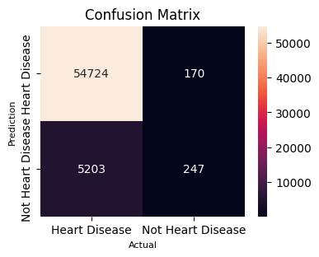
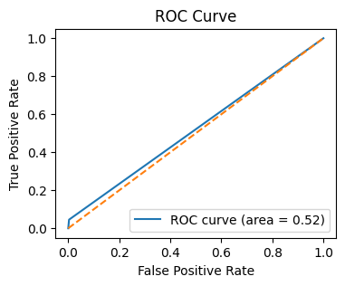
Results (Before Oversampling)
In total, we have implemented eight Machine Learning models such as Decision Tree, Random Forest, XGBoost, Gradient Boost, AdaBoost, SVM, Logistic Regression, and Nearest Neighbor. Among them, we got the best results from Random Forest.
Random Forest Results
Accuracy: 91.1%
Precision: 0.59
Recall: 0.045
AUC (Area under the curve) score: 0.52

Slide 7
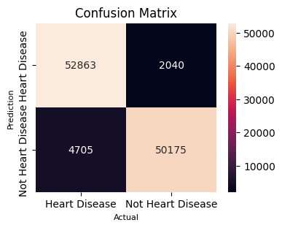
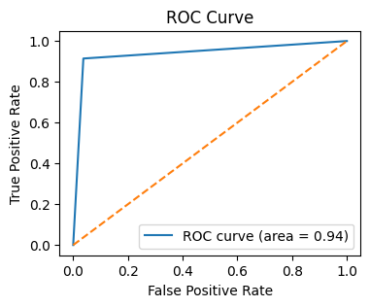
Results (After Oversampling)
NOTE: Even after oversampling the dataset, best results were obtained from Random Forest model.
Random Forest Results
Accuracy: 93.9%
Precision: 0.96
Recall: 0.91
AUC (Area under the curve) score: 0.94
For more: https://docs.google.com/document/d/1nfW9KHMBbvpvxiOMglLnaB87gYCswC_NQ6uA2DIc3jo/edit

Slide 8
THANK YOU

